Slide 1
Model for Network Security

Slide 2
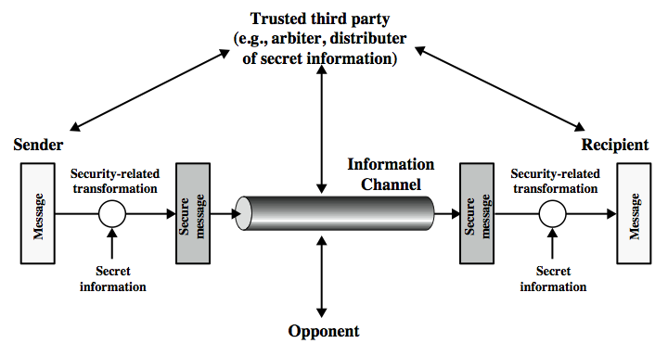
Model for Network Security

Slide 3
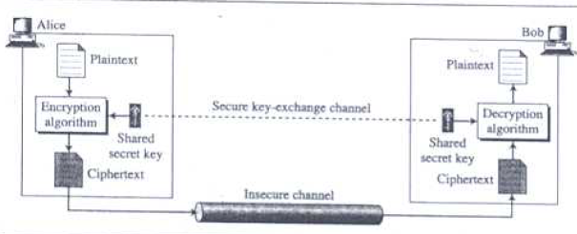
Model for Network Security

Slide 4
Model for Network Security
Using this model requires us to:
Design a suitable algorithm for the security transformation
Generate the secret information (keys) used by the algorithm
Develop methods to distribute and share the secret information (key)
Specify a protocol enabling the sender and receiver to use the transformation and key for a security service

Slide 5
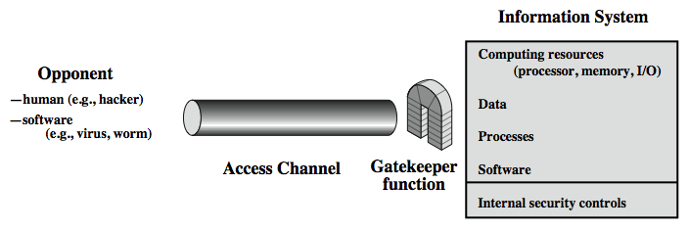
Model for Network Access Security

Slide 6
Model for Network Access Security
Using this model requires us to:
Select appropriate gatekeeper functions to identify users
Implement security controls to ensure only authorised users access designated information or resources
Note that model does not include:
monitoring of system for successful penetration
monitoring of authorized users for misuse
audit logging for forensic uses, etc.

Slide 7
Classic Encryption Techniques
Plain Text: Original Message
Encryption/Encipherment: Process of Converting from Plain tect to Cipher text
Decryption/Decipherment: Restoring the plaintext from the cip[her text.
Cryptography: Many schemes used for encryption.
Cryptanalysis: Techniques for deciphering a message without any knowledge of the enciphering details.
Cryptology: areas of Cryptography and Cryptanalysis together are called Cryptology

Slide 8
Classic Encryption Techniques
Encryption Algorithm: Performs various substitution and transpositions on the palintext.
Secret Key: Value independent of plain text and the algorithm.
Cipher Text: Scrambled Message produced as Output.
Decryption Algorithm: Encryption Algorithm in reverse.

Slide 9
Classic Encryption Techniques
Two Requirements of Conventional Algorithm
Strong Encryption Algorithm: Opponent who knows the algorithm and have access to one or more Cipher texts would be unable to decipher the ciphertext and discovery the key.
Sender and receiver must have obtained copies of the secret key in a secure fashion and must keep the key secure.

